Slide 1
School of Geography and Geology
McMaster University
Advanced Topics in Spatial Statistics
Session 11
Spatially Continuous Data II

Slide 2
This session
Trend surface analysis (cont’d)
  Matrix notation
  Example: Walker Lake
Studying spatial structure
  Covariogram and variogram
  Empirical variogram
  Variogram models
  Fitting variogram models

Slide 3
Trend Surface Analysis
A method to model the first order component of a spatial process
Multiple regression analysis using the coordinates of the points as explanatory variables

Slide 4
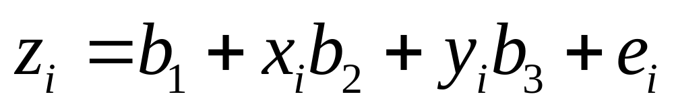
Trend Surface Analysis
Linear trend surface
  z: objective variable
  b₁ , b₂ , b₃: regression parameters
  x , y: coordinates of point i

Slide 5
Trend Surface Analysis:
Linear Trend
Y
b₂
X₂
b₁
a
X₁

Slide 6
Trend Surface Analysis
Quadratic trend surface
  z: objective variable
  b₁ , b₂ ,…, b₆ : regression parameters
  x , y: coordinates of point i

Slide 7
Trend Surface Analysis
Higher order polynomials
  Cubic
  Quartic
  …

Slide 8
Trend Surface Analysis
Potential issues
  Multicollinearity
  Trend surfaces tend to “curl” around the edges
Wolfcamp Aquifer example: fairly good fit

Slide 9
Regression Analysis: Matrix Notation
Linear trend surface

Slide 10
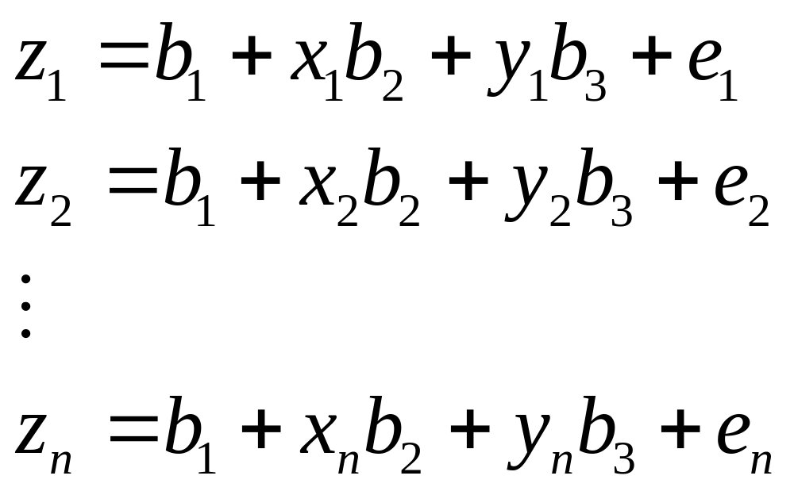
Regression Analysis: Matrix Notation
Linear trend surface

Slide 11
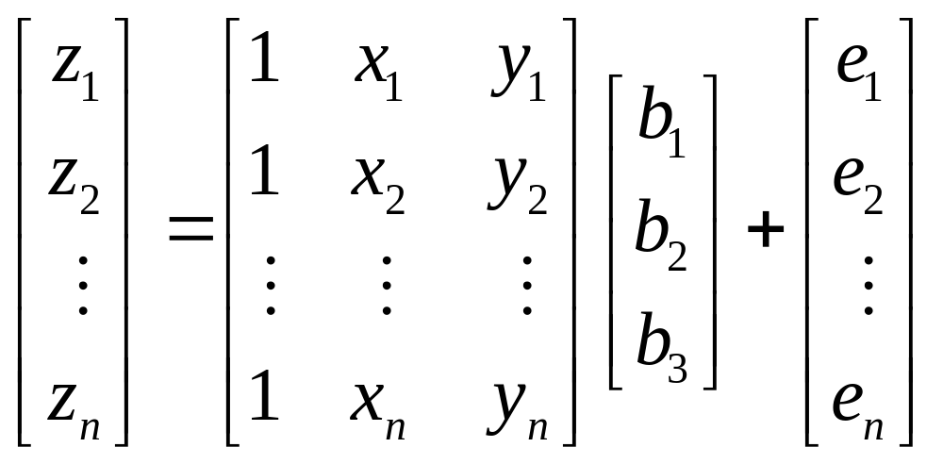
Regression Analysis: Matrix Notation
Linear trend surface

Slide 12
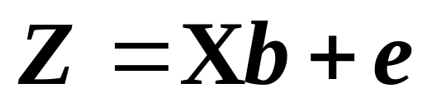
Regression Analysis: Matrix Notation
Linear trend surface

Slide 13
Regression Analysis: Assumptions
Error terms

Slide 14
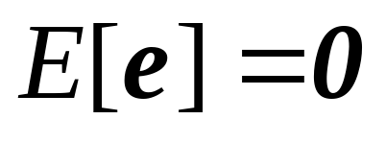
Regression Analysis: Assumptions
Error terms
  Expected (mean) value = 0

Slide 15
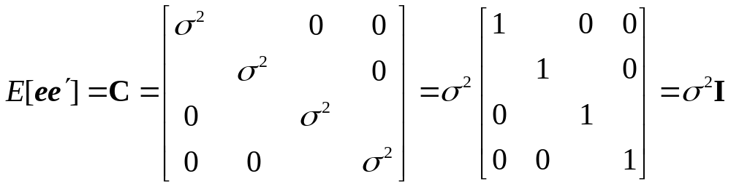
Regression Analysis: Assumptions
Error terms
  Constant variance
  Independent

Slide 16
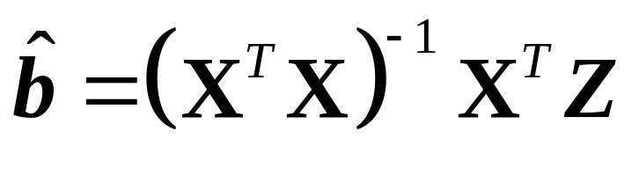
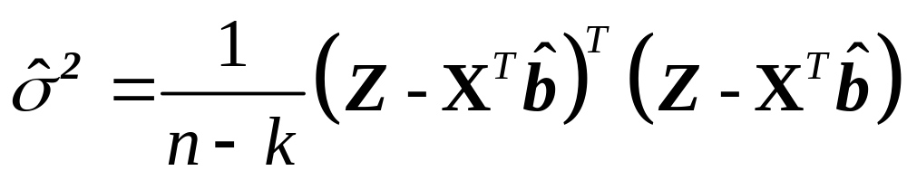
Regression Analysis: Estimation
Parameters
Variance

Slide 17
Example
Walker Lake (Nevada)
  Concentration of pollution
  Soil remediation
Data
  470 observations (pollution ppm)
Geostatistical problem
  Produce indicator maps showing the areas where pollution concentrations exceed a given threshold

Slide 18
Example: Walker Lake
Spatial distribution of observations

Slide 19
Trend Surface Analysis
Linear trend surface
Quadratic trend surface
Cubic trend surface

Slide 20
Trend Surface Analysis
In addition to multicolinearity and curly surfaces

Slide 21
Trend Surface Analysis
In addition to multicollinearity and curly surfaces
Spatial structure is missing
  Covariance matrix will not be diagonal!

Slide 22
Describing Spatial Structure
Q: How can we describe spatial structure?
  Covariogram
  Variogram
  Correlogram

Slide 23
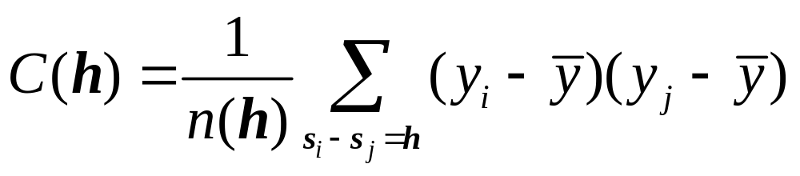
Covariogram
A plot of the covariance of the process at various spatial lags

Slide 24
Covariogram
C(0)=σ²
h

Slide 25
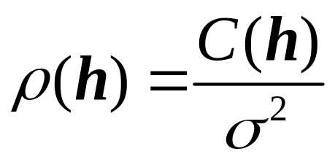
Correlogram
ρ(0)=1
h

Slide 26
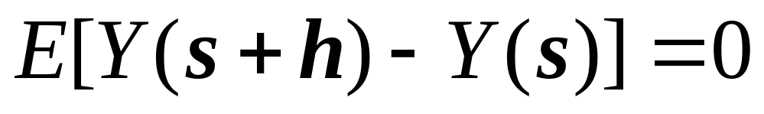
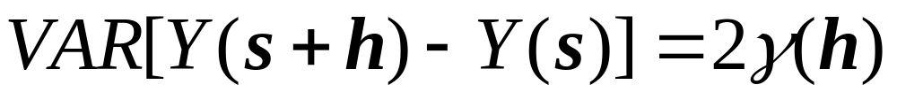
Variogram
Intrinsic stationarity (weaker assumption)

Slide 27
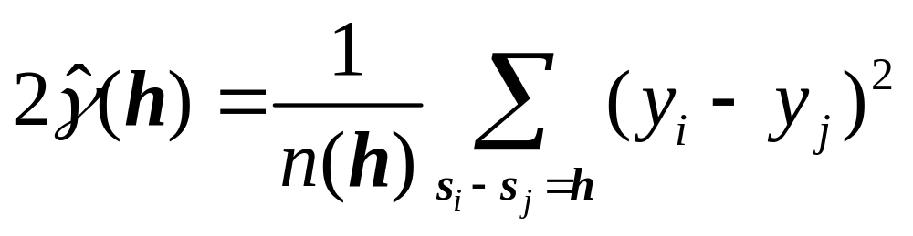
Variogram
Intrinsic stationarity

Slide 28

Variogram
σ²
Sill
Range
h

Slide 29
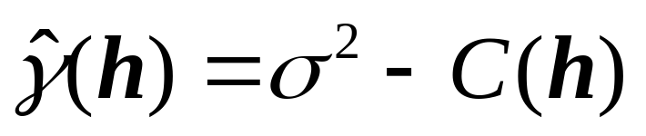
Covariogram, correlogram, variogram
Covariogram C(h)
Correlogram
C(0)=σ²
ρ(0)=1
h
h
Variogram
σ²
h

Slide 30
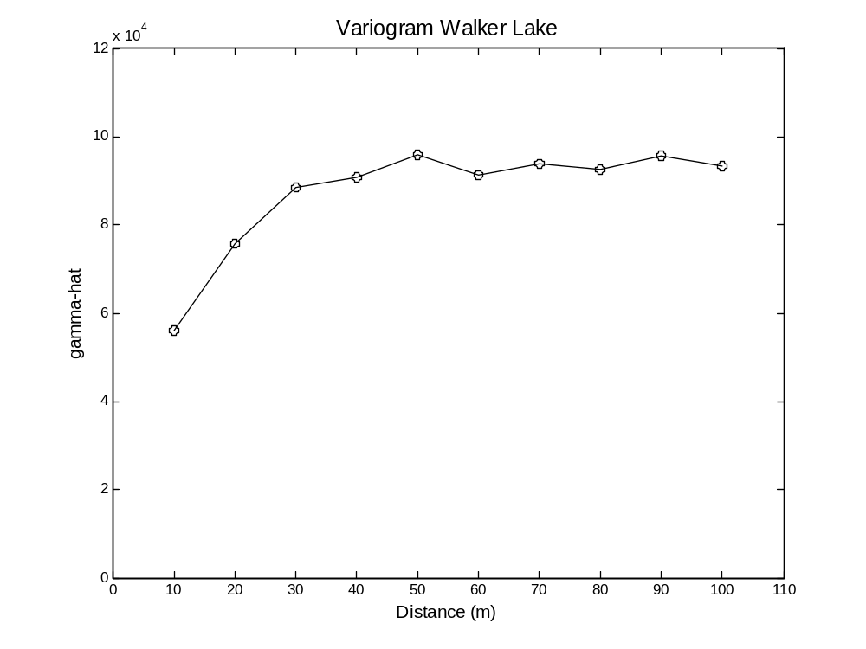
Describing Spatial Structure
Empirical Variogram

Slide 31
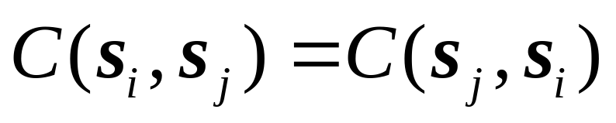
Variogram Models
A theoretical model that fits the empirical variogram
The variogram model should produce a covariance matrix that is:
  Symmetric
  Non-negative definite

Slide 32
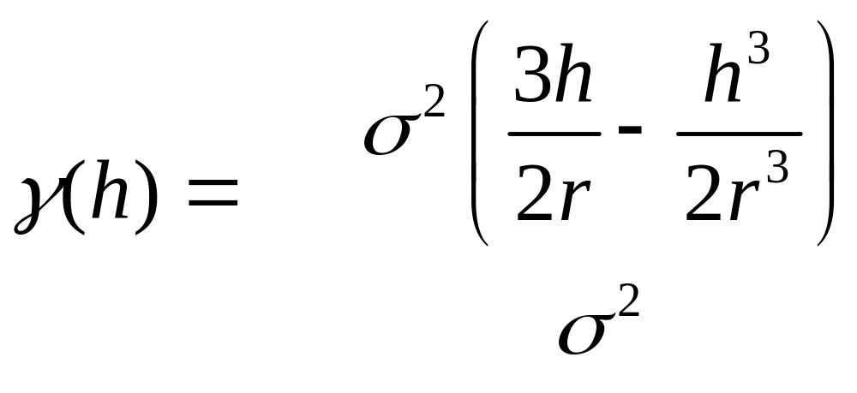
Variogram Models
Spherical
for h ≤ r
otherwise

Slide 33
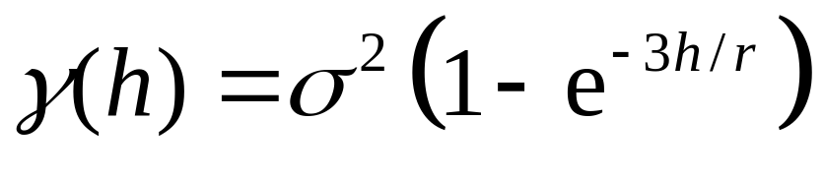
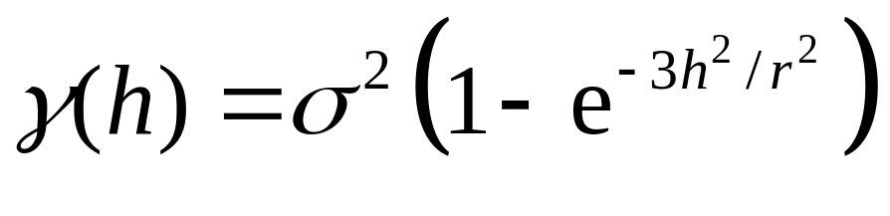
Variogram Models
Exponential
Gaussian

Slide 34
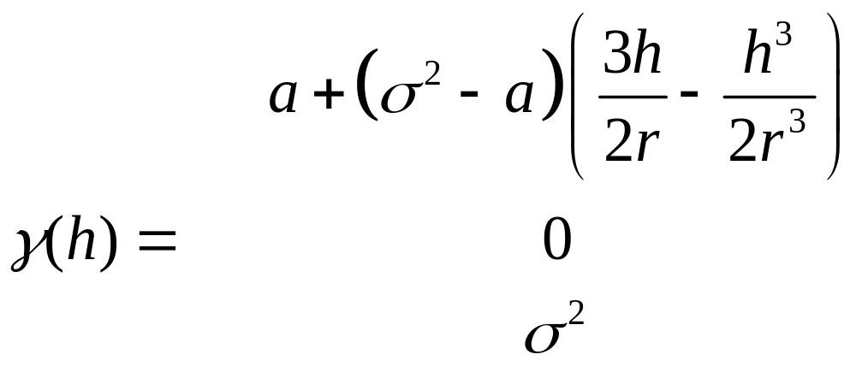
Variogram Models
Spherical with nugget effect
for 0 < h ≤ r
for h = 0
otherwise

Slide 35
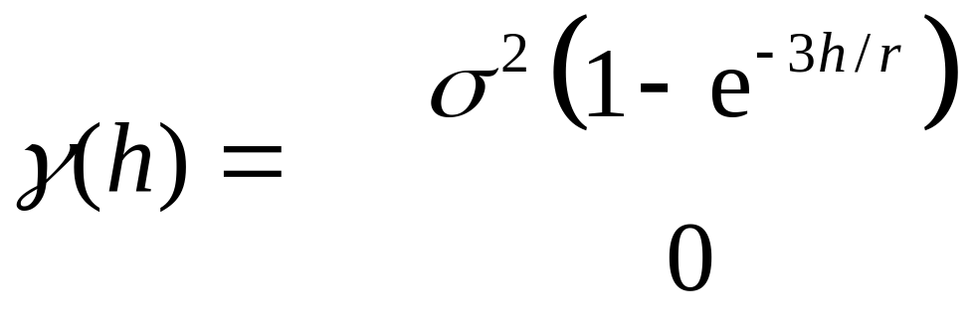
Variogram Models
Exponential with nugget effect
for h > 0
for h = 0

Slide 36
Variogram Models
Fitting variogram models
  Non-linear least squares

Slide 37
Variogram Models
Relative nugget effect
  The ratio of the nugget effect to the sill
  A relative nugget effect of 100% indicates complete lack of spatial dependence

Slide 38
Next…
Spatially continuous data III
  Spatial interpolation
  Kriging

